Slide 1


WELCOME TO FRANKFURT SCHOOL

Slide 2
Data Science Techniques and Real-
World Applications
Exploratory Data Analysis (EDA) & Visualizations
Zahra Sharafi
https://sites.google.com/view/zahrasharafi/home
Email: z.sharafi@fs.de
2
Notes:
2

Slide 3
Agenda
Exploratory Data Analysis
(ch3. Data Analysis for Business, Economics, and Policy)
Auto EDA tools
Visualization tips
(based on storytelling with data, https://www.storytellingwithdata.com/ )
Matplotlib
3

Slide 4
Overview
What is EDA? What it does?
Process of EDA
Univariate, Bivariate, Multivariate analysis
Interactions among attributes
Detect data irregularities
Feature Engineering
Auto EDA
Why automate EDA process?
Some Auto EDA Libraries
Comparison
4

Slide 5
Exploratory data analysis (EDA)
﻿Collecting the data
Assessing its quality
Cleaning it
Structuring it
➡️ Exploratory data analysis (EDA)
Goal:
Informative descriptive analysis
Answer to some preliminary questions
Deeper understanding of variables in a dataset.
Range of data
Extreme values (outliers)
Spotting potential problems with the data
Needs for additional data cleaning (?)
Path for further steps of the analysis
Uncovering new patterns and correlations in the data
Test hypotheses and check assumptions with the help of summary statistics and visualizations.
5

Slide 6
What is EDA
Short for explorative data analysis
Invented by John Tukey in 1970s
Now used by data scientists to analyze and investigate datasets and to
Summarize their key features
Check assumptions
Enables data scientists to spot patterns, find anomalies, test hypotheses or
Usually adopts techniques such as data visualization methods
6

Slide 7
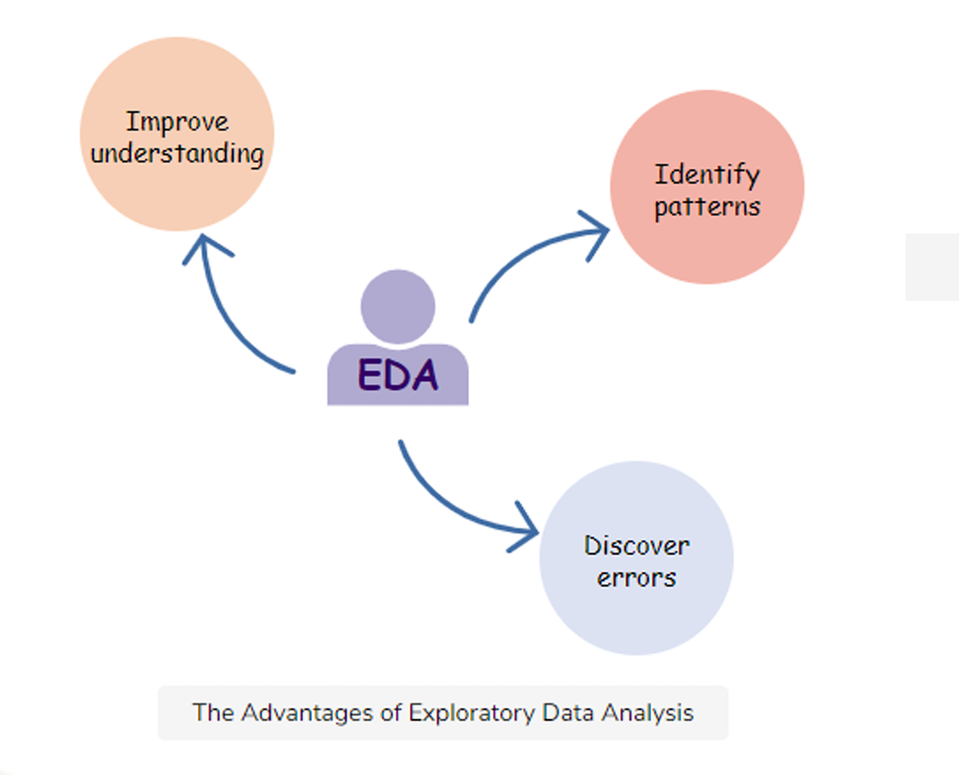
What it does?
7

Slide 8
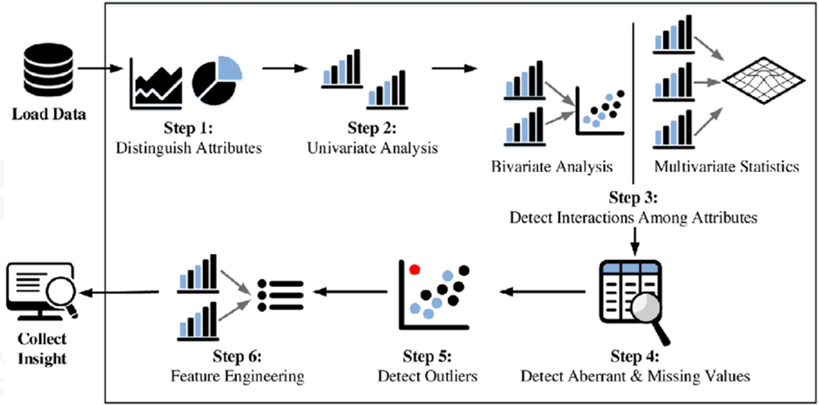
Process of EDA
8

Slide 9
Process of EDA - Univariate, Bivariate, Multivariate analysis
Univariate analysis
the examination of only one variable at a time
Bivariate analysis
the examination of two variables simultaneously
Multivariate analysis
the examination of more than two variables simultaneously
9

Slide 10
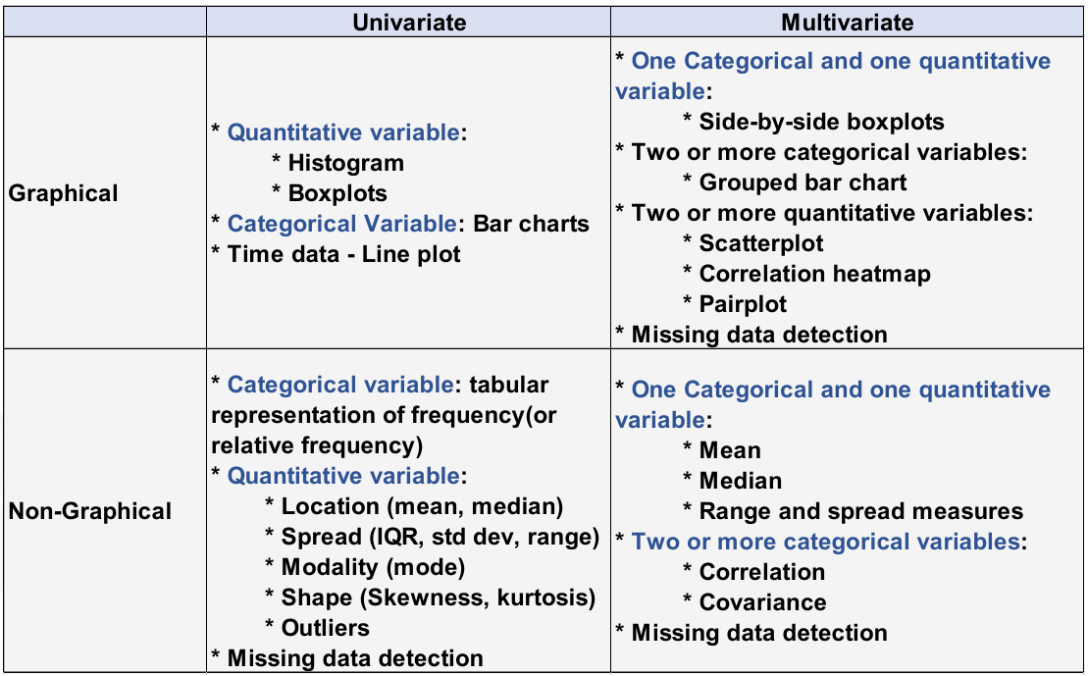
Process of EDA - Univariate, Bivariate, Multivariate analysis
10

Slide 11
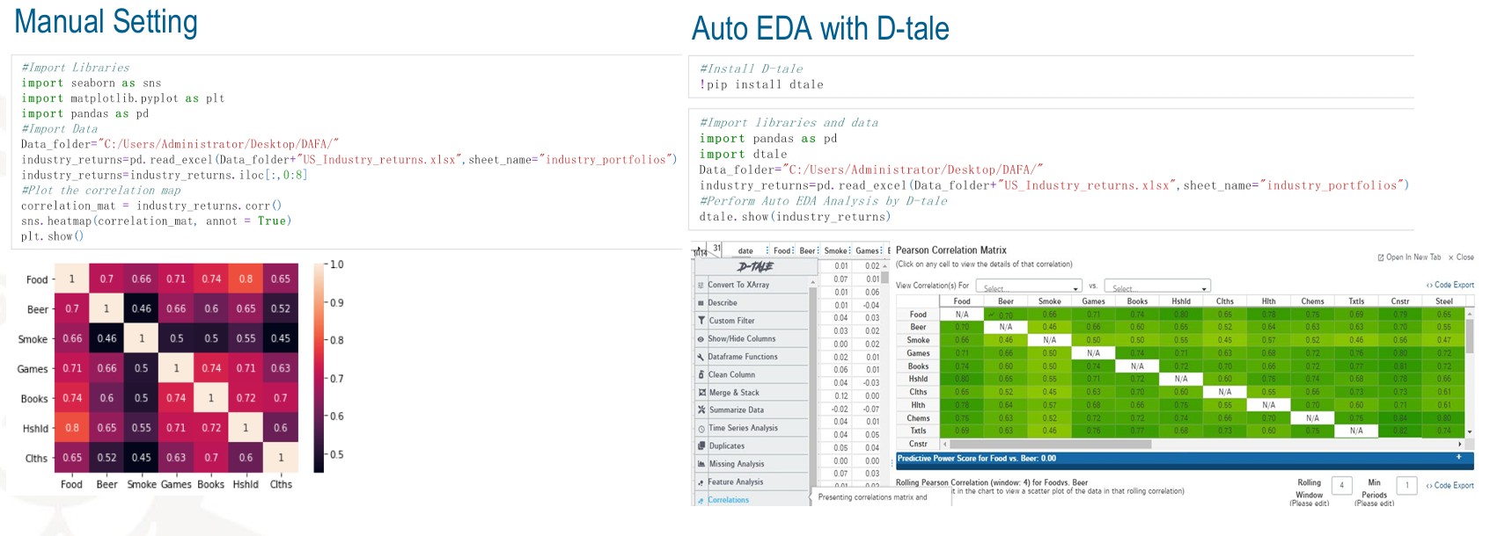
Process of finding relationships between two or more variables
Example: Covariance between variables
11

Slide 12
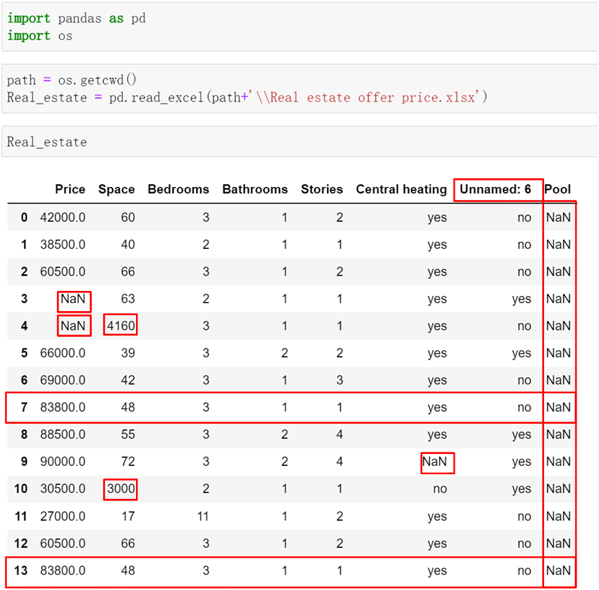
Process of EDA – Detect data irregularities
Handling missing values
Detect duplicates
Check outliers
12

Slide 13
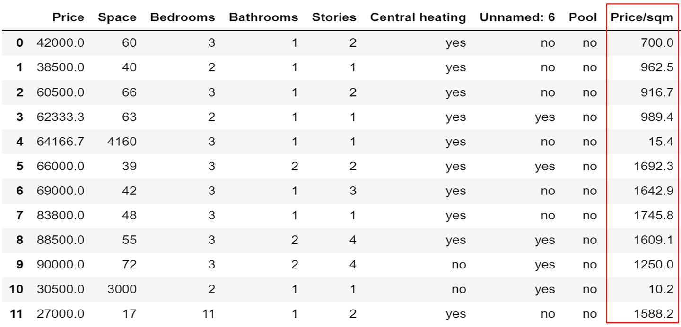
Steps In Exploratory Data Analysis: Feature Engineering
Objective: To make data compatible with further processing
13

Slide 14
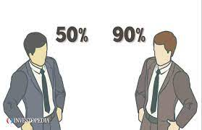
Frequency vs. Probability
Absolute Frequency: count
Relative Frequency: in relative terms or %
Probability: likelihood of an event
0 ≤ P(event) ≤ 1.
Based on historical relative frequencies
Is Probability always a relative frequency?
Subjective probability
14
Notes:
Definition: Probability represents a person’s degree of belief in an event occurring, based on personal judgment, intuition, or available information—not necessarily past data.

Slide 15
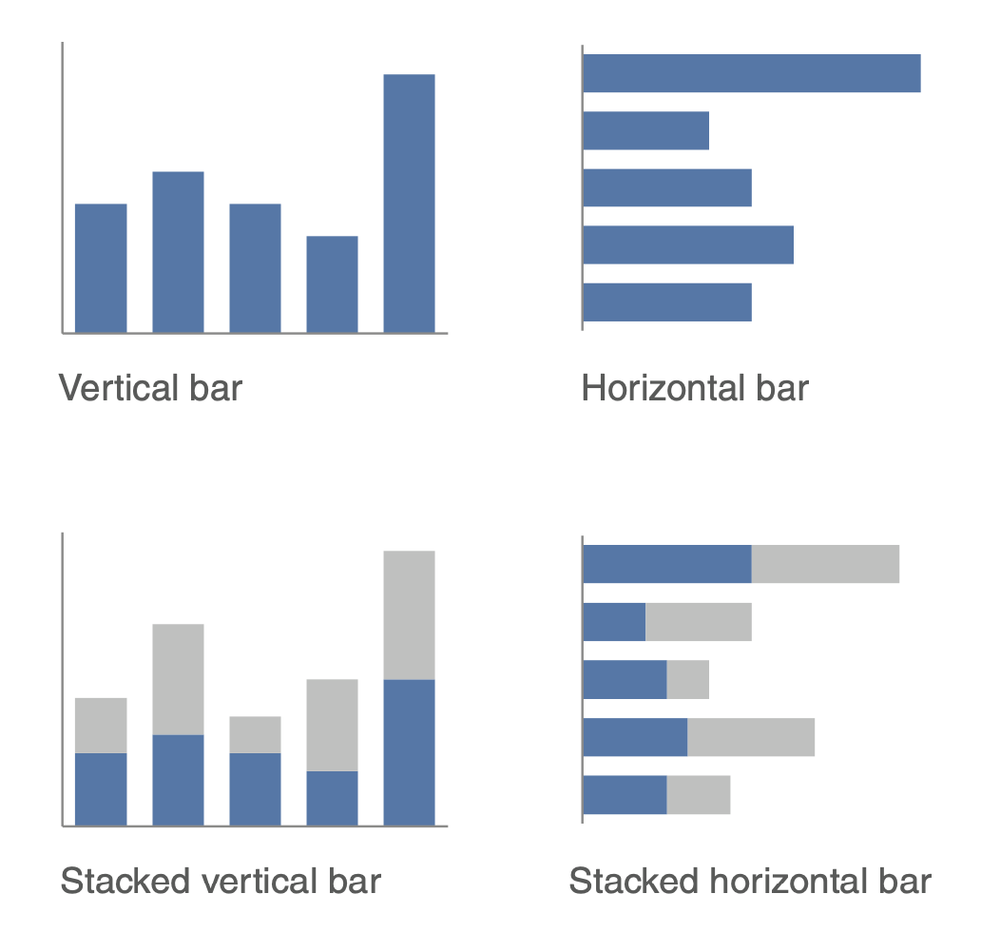
Distributions
﻿The frequency of each value of the variable in the data
First step of EDA is to plot the distribution of important variables
Histograms
Decide on optimal Bin size:
Details vs. distribution overview
(horizontal) Bar plots
Density plots
Kernel density estimates
15

Slide 16
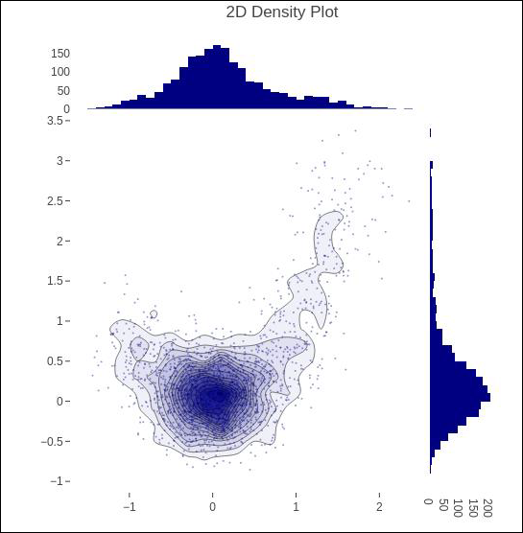
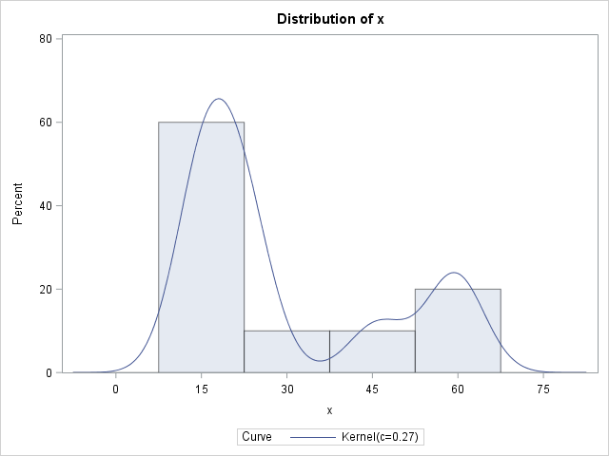
Distributions
Things to note:
Model(s): center(s) and tails
Skewness
Extreme values
Log-normality
16

Slide 17
Extreme values (Outliers)
﻿Substantially larger/smaller values for one or a handful of observations than the rest.
Could be:
Due to error: Unit errors: E.g., firms’ revenue in $m, flow variables in different time frames, …
Part of the data: returns on a sample of distressed firms, personal monthly medical expenditures, salaries, …
What to do?
For errors: correct if possible, otherwise convert to missing (NaN)
Reframing the analysis scope:
Censoring: trimming or truncation
Winsorizing: replace extreme values with the 95th percentile
17

Slide 18
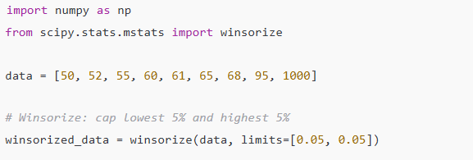
Extreme values (Outliers)
Winsorizing: replace extreme values with the 95th percentile

Slide 19
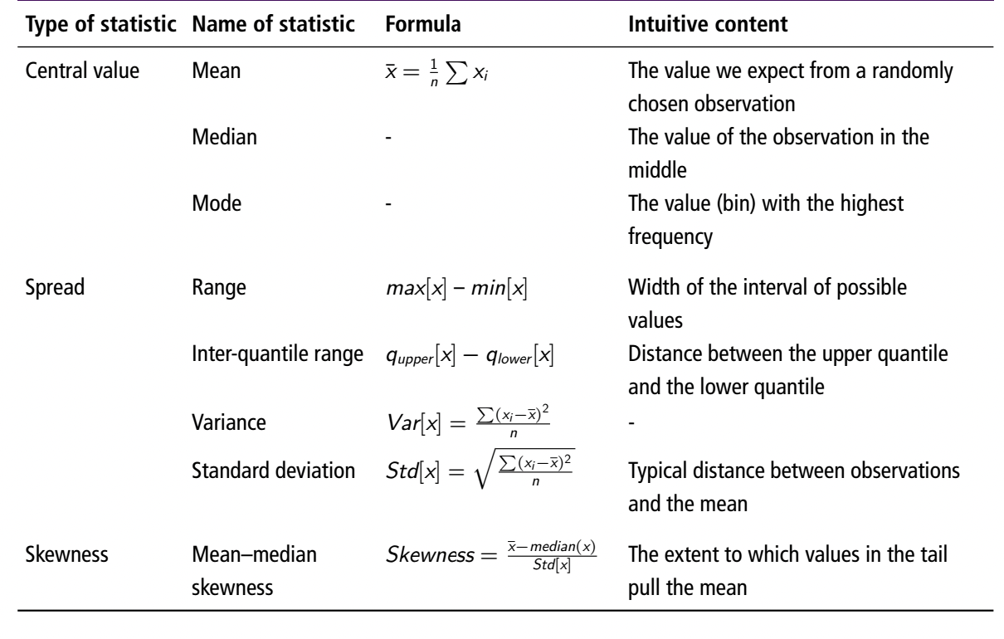
Summary Statistics
19

Slide 20
Summary Statistics
Moments are a way of summarizing the shape of a distribution.
1st moment (mean): central location
2nd moment (variance / standard deviation): spread
3rd moment (skewness): asymmetry
4th moment (kurtosis): tail heaviness (higher chance of outliers)

Slide 21
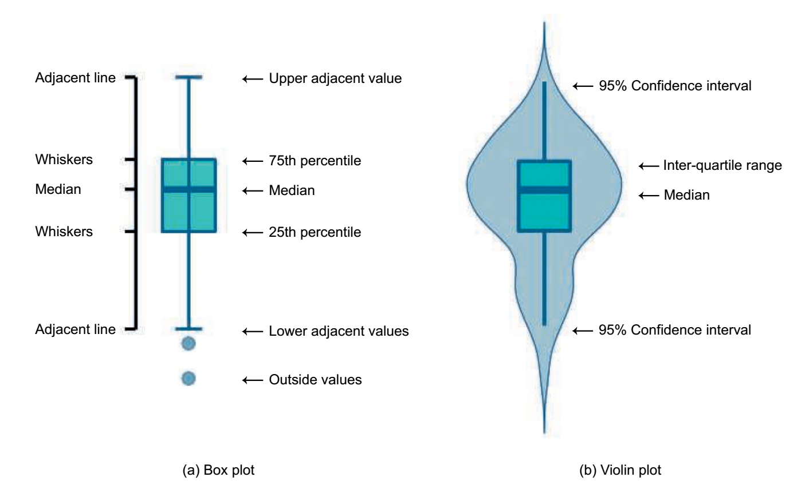
Summary Statistics
21

Slide 22
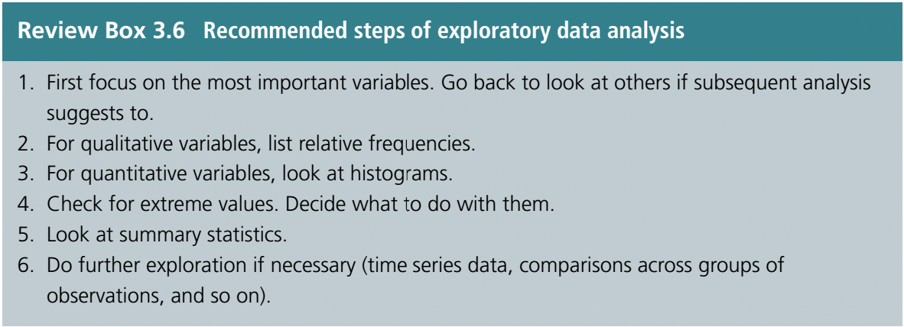
22

Slide 23
Automatic Exploratory Data Analysis (EDA) tools
There are Python (or R) libraries that generate summary statistics, visualizations, and insights about your dataset with very little code.
They’re super handy when you want to quickly understand the structure, quality, and patterns in your data.
Some Python packages perform an EDA for your pandas data frames.
Examples are provided in the following notebook: https://www.kaggle.com/code/andreshg/automatic-eda-libraries-comparisson
23

Slide 24
Now to the code…
P05 AutoEDA.ipynb

Slide 25
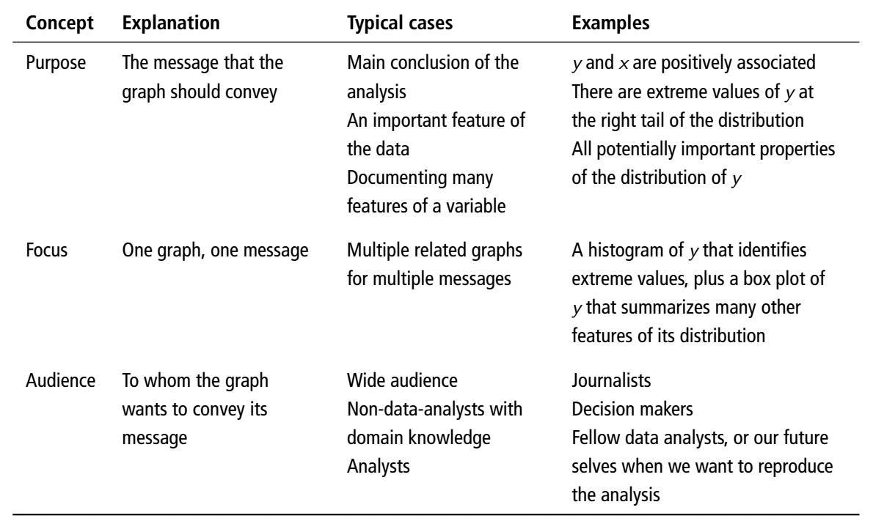
Visualization
25

Slide 26
Bad graphs (based on storytelling with data https://www.storytellingwithdata.com/ )
“bad graphs” are those that fail to communicate insights clearly and effectively.
They may contain technically correct data, but the design choices get in the way of the story, confuse the reader, or even mislead.
Here are the key types of bad graphs and why they are problematic:
Too Much Clutter
Wrong Chart Type
Poor Use of Color
Unnecessary Complexity
Misleading Axes
Ineffective Labeling
Pie and Donut Charts with Too Many Slices
Overloading with Numbers
Ignoring the Audience

Slide 27
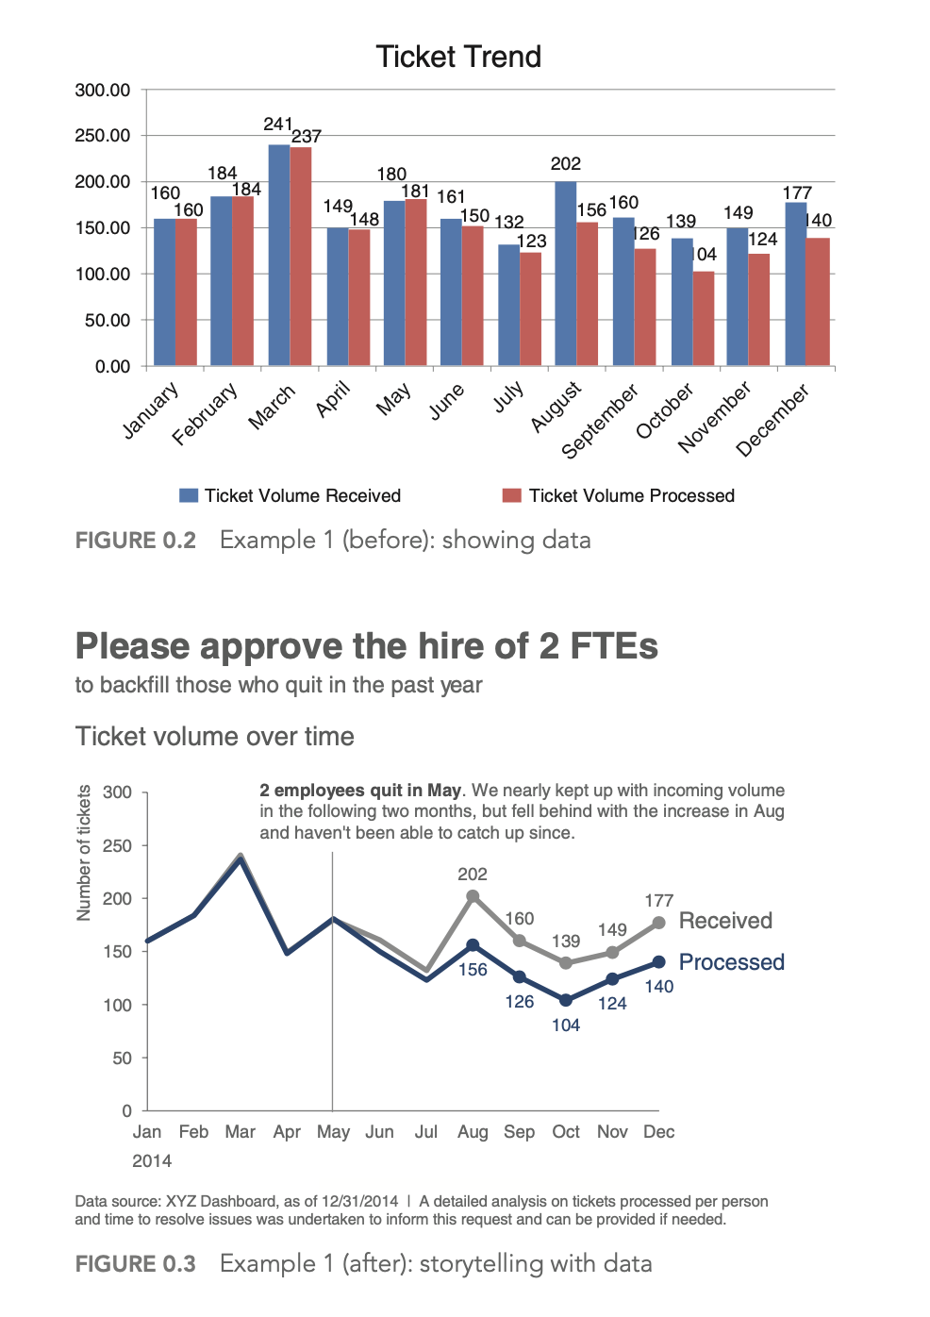
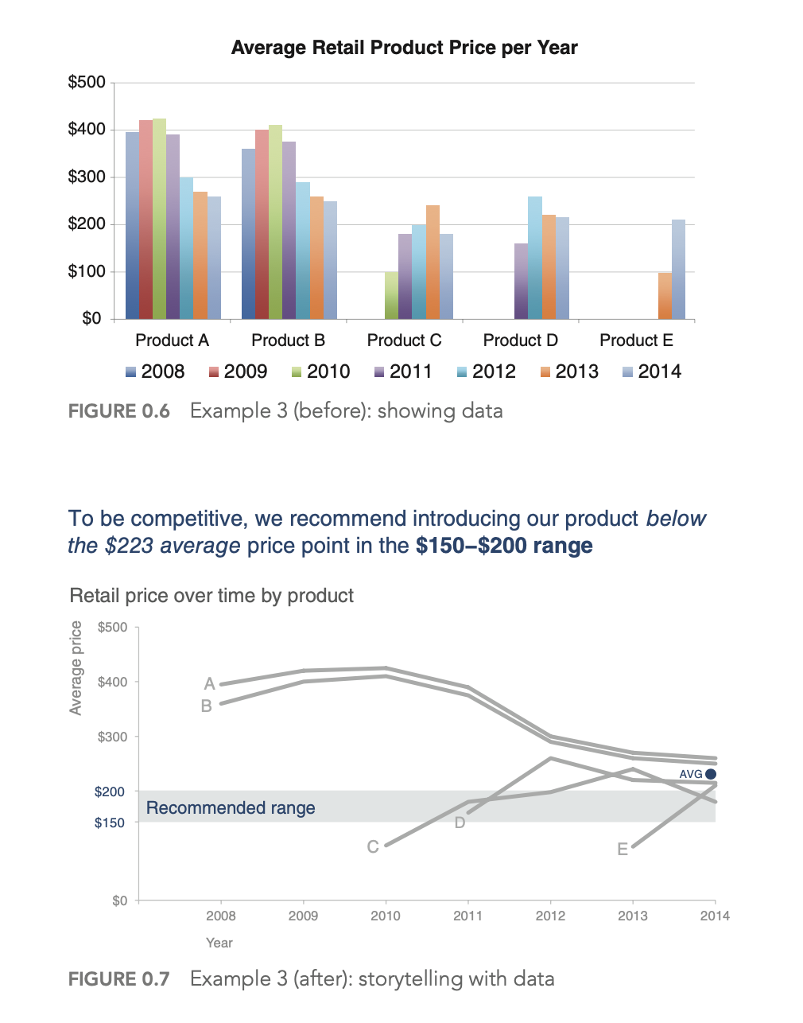
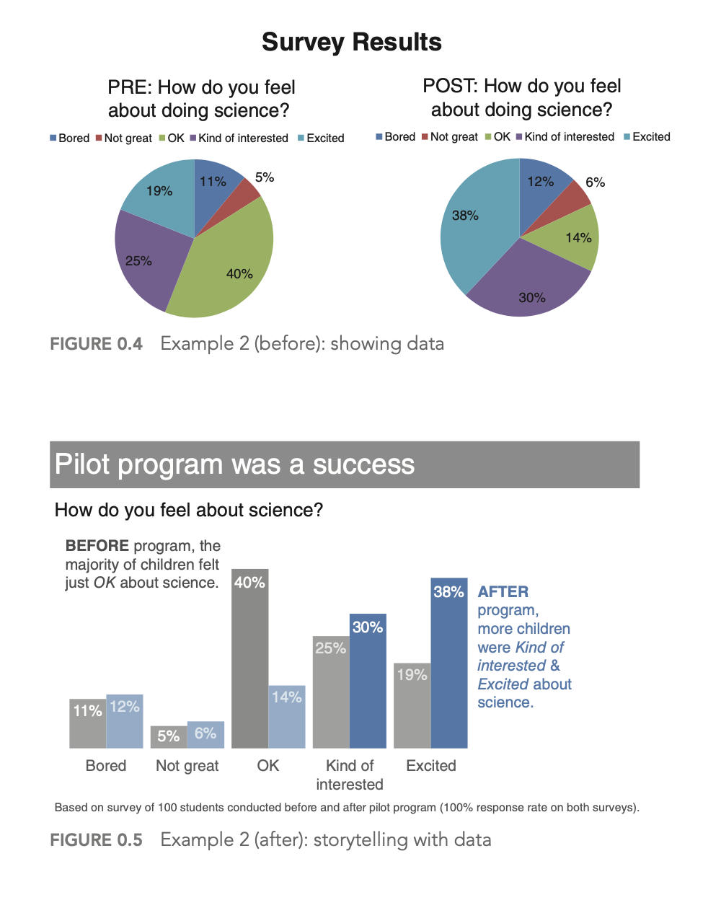
Bad graphs (based on storytelling with data https://www.storytellingwithdata.com/ )

Slide 28
Roadmap
Understand the context
Who is your audience? What do you need them to know or do?
Choose an appropriate visual display
What is the best way to show the data you want to communicate?
Eliminate clutter
How to find disorders
Focus attention where you want it
Take care of visual cues
Think like a designer
Tell a story
Communicate with data
28

Slide 29
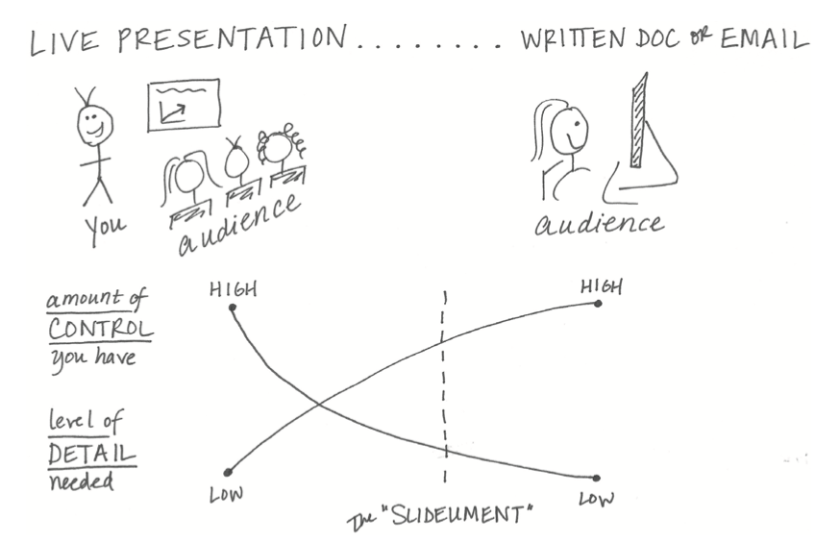
1. Context
Exploratory vs. explanatory analysis
Identify the audience
How much detail do you need to communicate
Depending on your audience/goals, make a shift toward explanatory analysis
Prioritize among the messages you want to convey
29

Slide 30
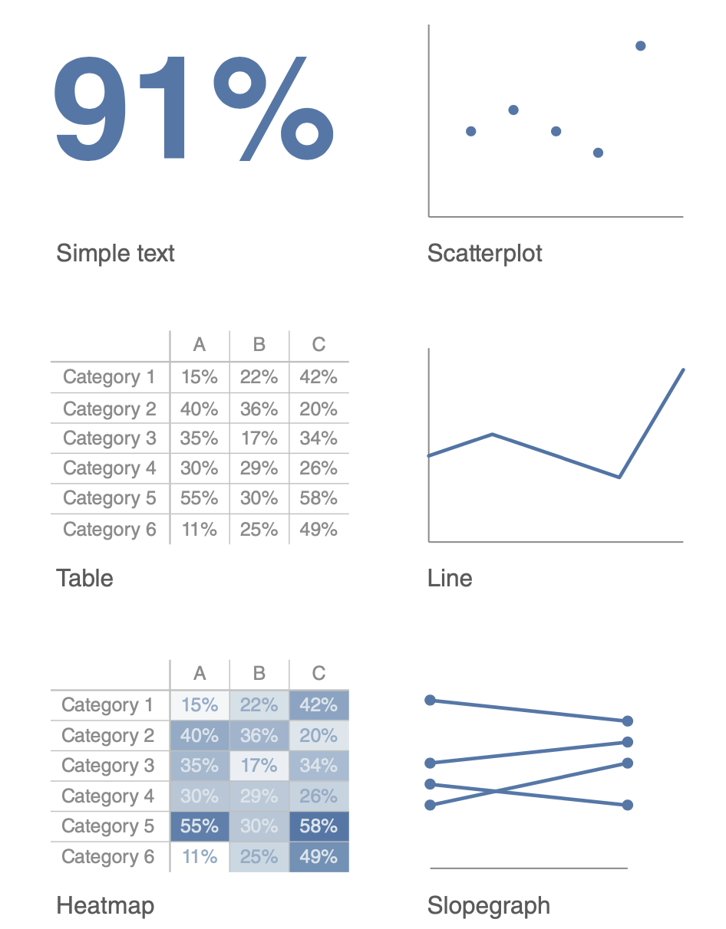
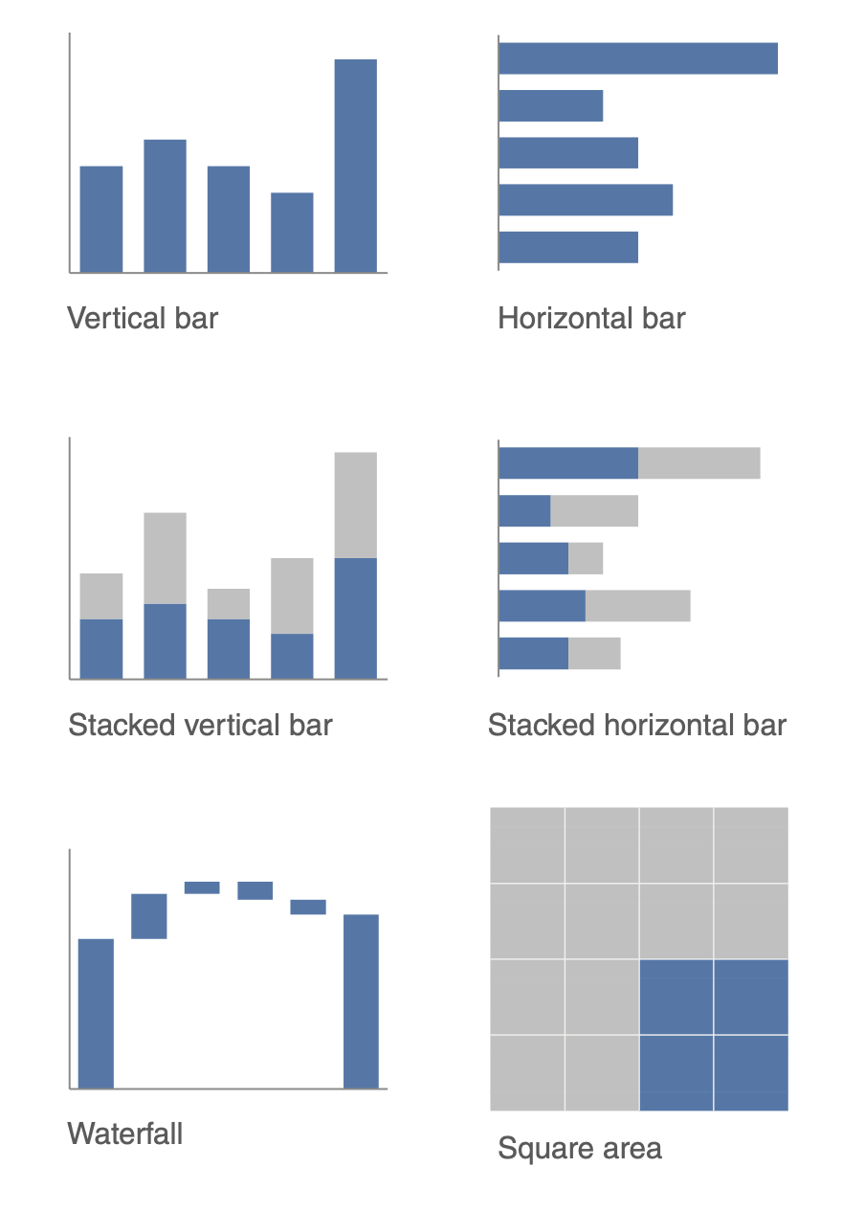
2.Choose an effective visual
30

Slide 31
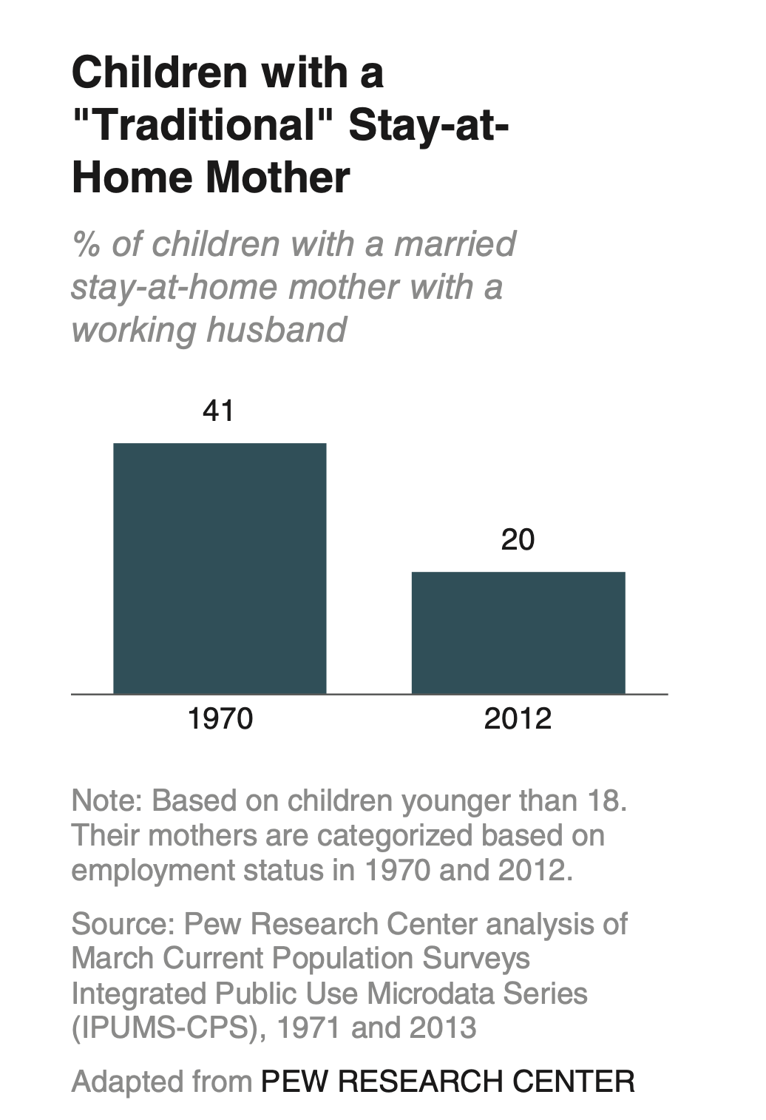
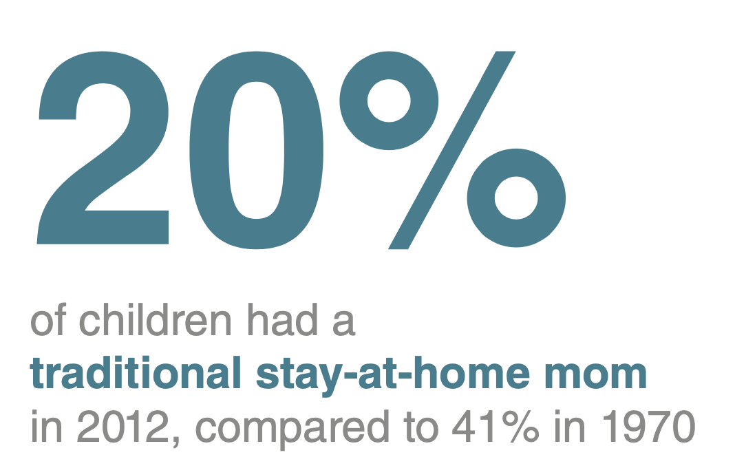
When you have just a number or two to share:
31

Slide 32
When you have a mixed audience, each interested in a particular number in a row/column
E.g: Different units of numbers in a row
In live presentations, tables kill the attention of the speakers
32

Slide 33
Color saturations reduce the mental process of comparing numbers in a table.
33

Slide 34
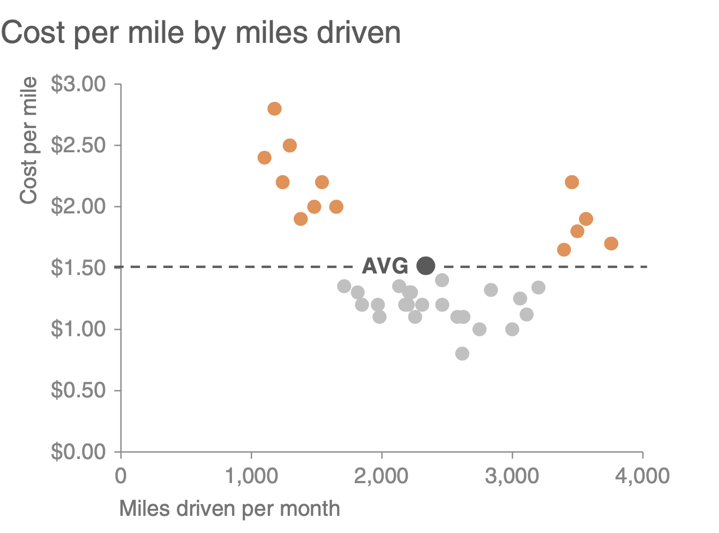
Useful for showing the relationship between two variables
Use line/colors for meaningful groupings:
34

Slide 35
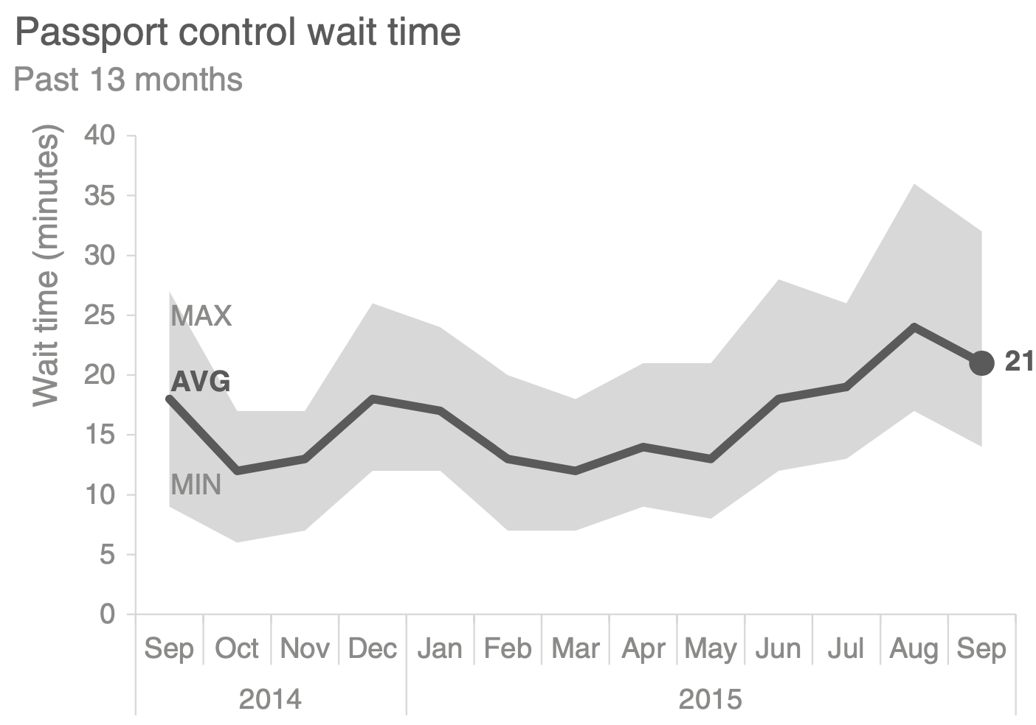
Mostly used for “continuous” variables
Highlight the average, and summary statistics:
35

Slide 36
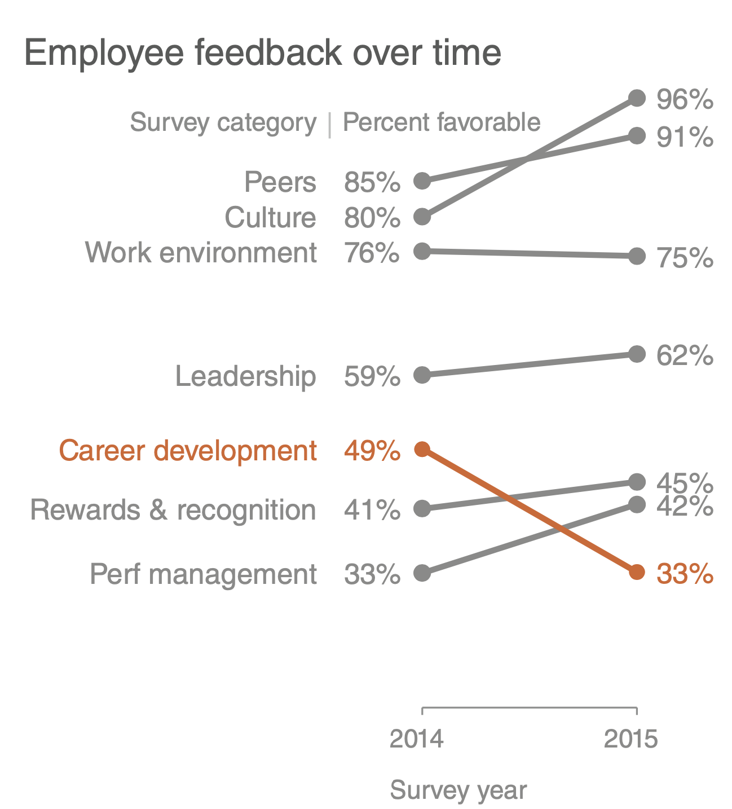
Slopegraphs can be useful when you have two time periods and want to quickly show relative increases and decreases or differences across various categories between the two data points.
Using Matplotly: https://towardsdatascience.com/slope-charts-with-pythons-matplotlib-2c3456c137b8
36

Slide 37
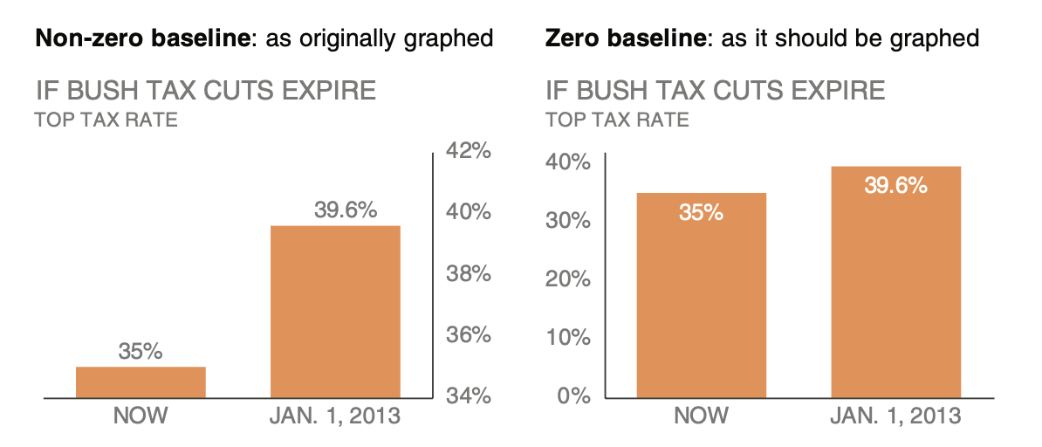
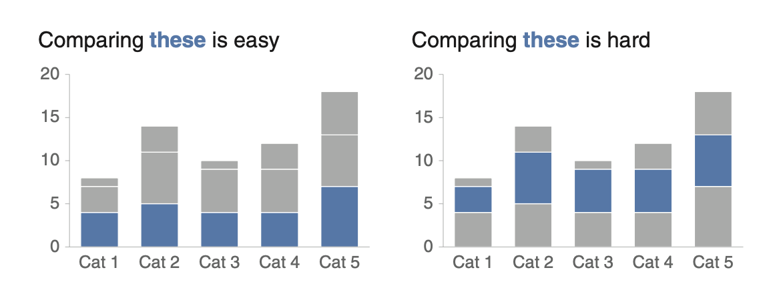
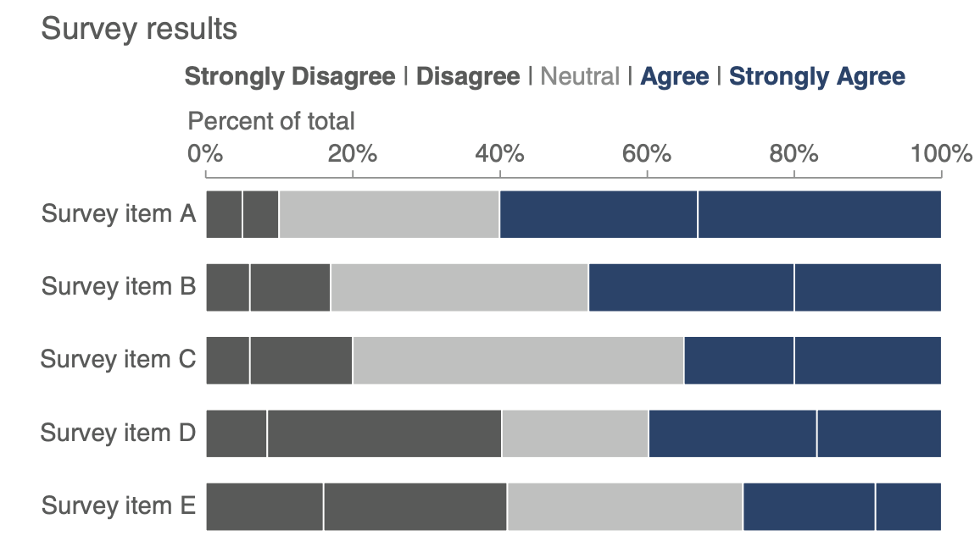
Level all bars on a zero baseline
Omit the numbers on the bar if the number isn’t very important
If stacking, put the most important subgroup at the bottom
For stacked bars, consider a total of 100%
Avoid too thin/thick bars
37

Slide 38
A waterfall graph (also called a waterfall chart) is a type of data visualization that helps you see how an initial value is affected by a series of intermediate positive or negative values, leading to a final result.
Perfect for elaborating on pieces of a stacked “bar” chart
https://medium.com/geekculture/creating-a-waterfall-chart-in-python-dc7bcddecb45
https://plotly.com/python/waterfall-charts/
38

Slide 39
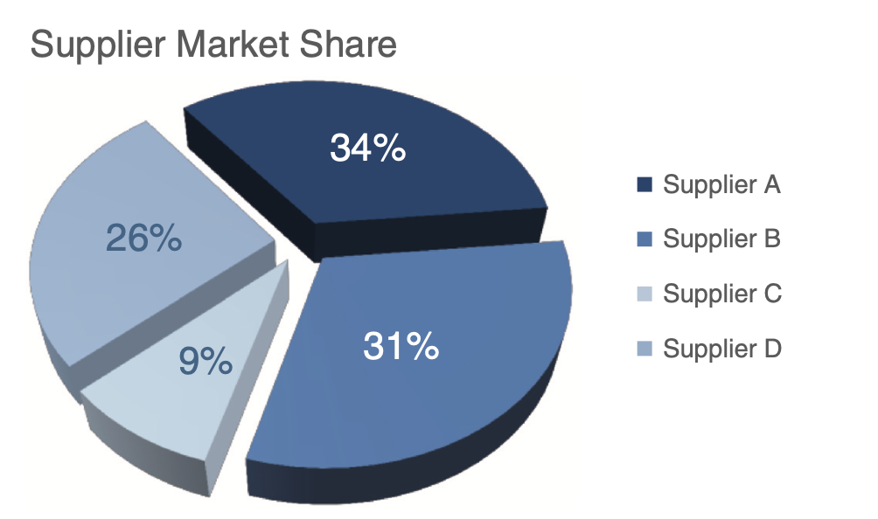
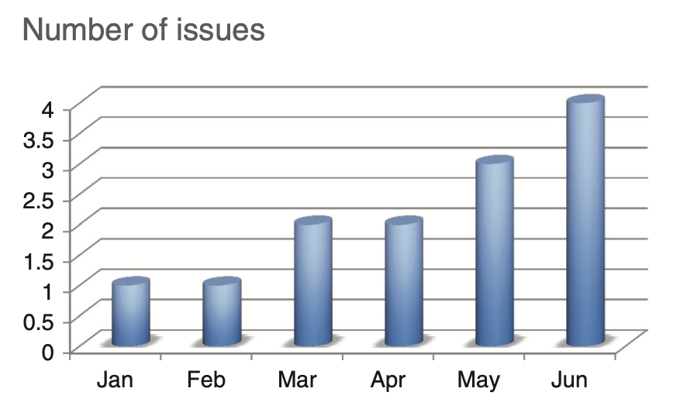
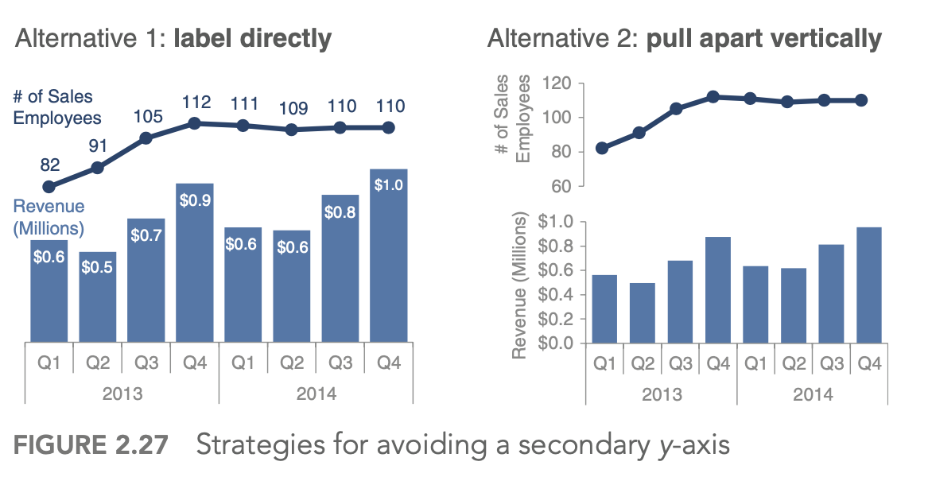
Pie charts and More tips
Pie charts
Nevers use without labelled segments
Make sure if bar plots are not a better choice
3-D charts
Never use, unless exploiting the 3rd dimension
Avoid secondary y axis:
39

Slide 40
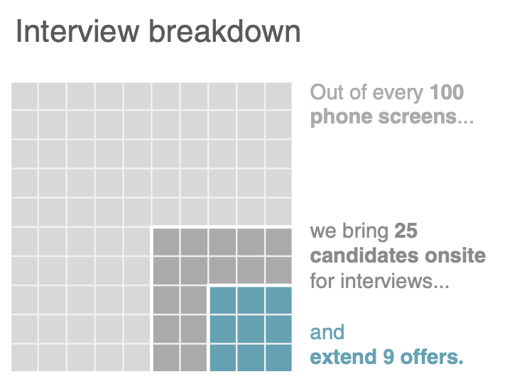
The square area chart can work as an alternative to the pie chart.
Great for comparing numbers of different magnitudes
Also known as Waffle charts
https://stackoverflow.com/questions/41400136/how-to-do-waffle-charts-in-python-square-piechart
40

Slide 41
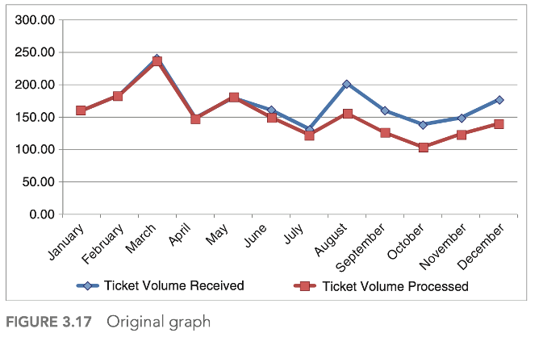
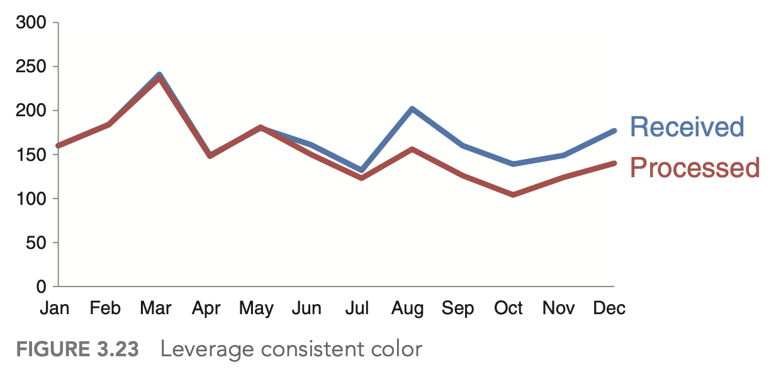
3. Decluttering
Visual clutter creates excessive cognitive load that can hinder the transmission of our message.
41

Slide 42
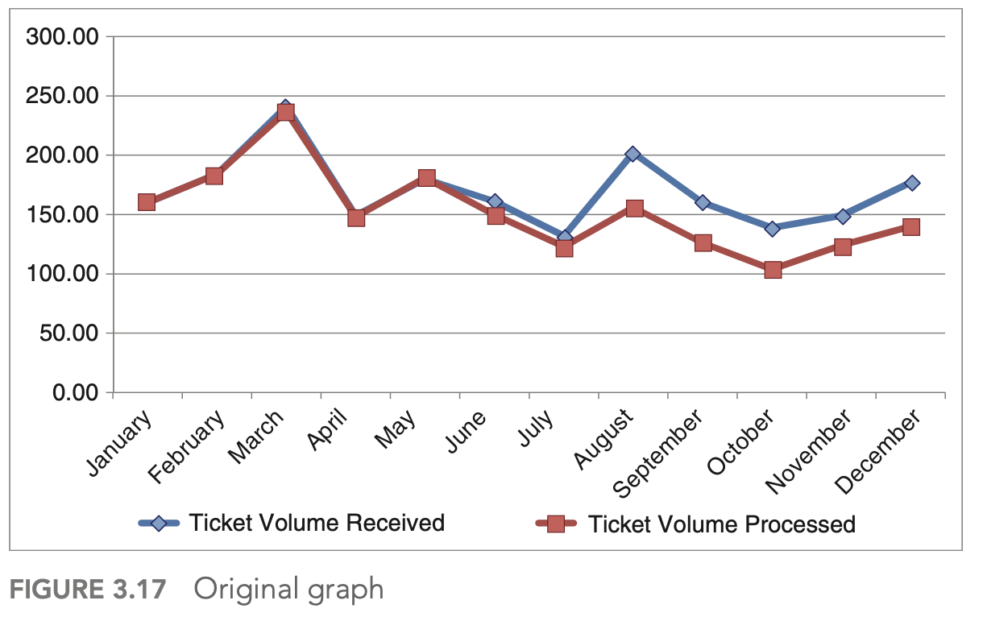
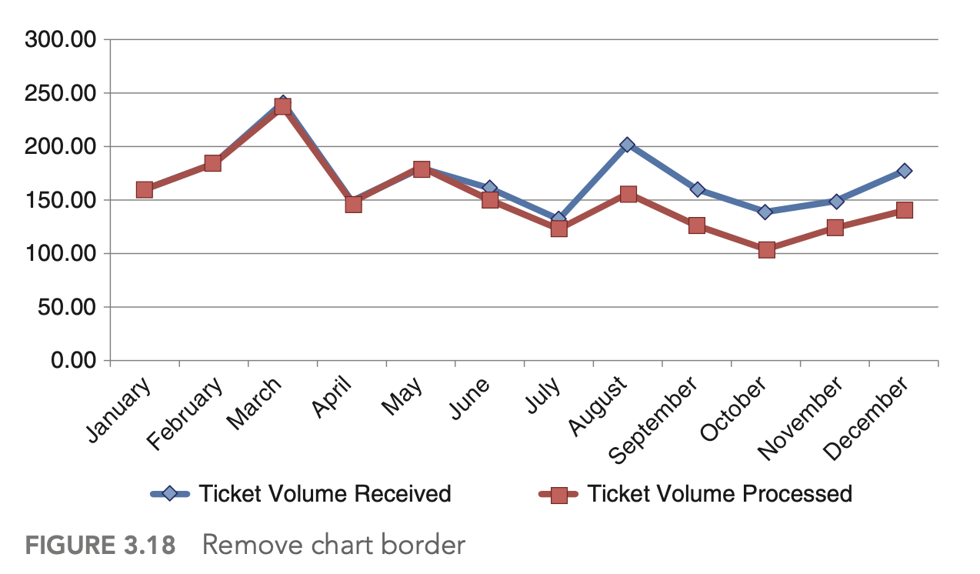
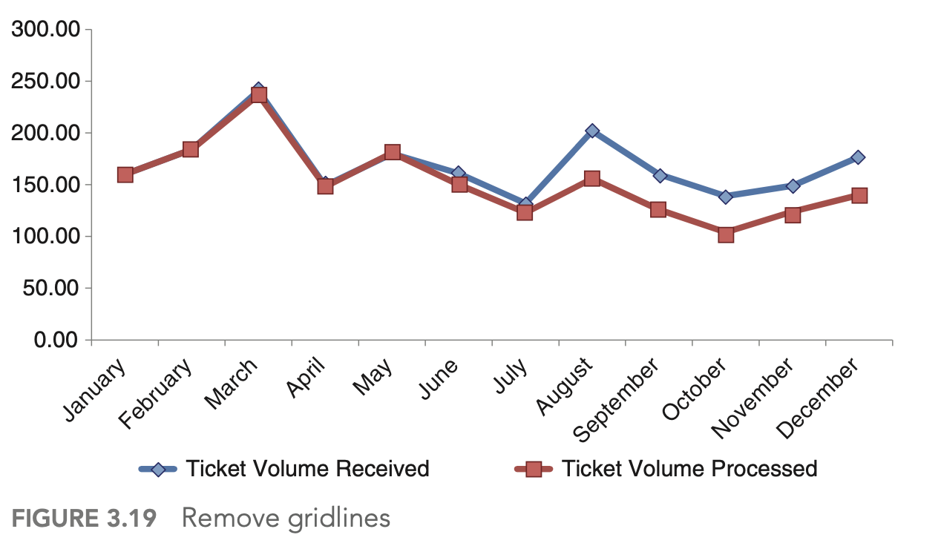
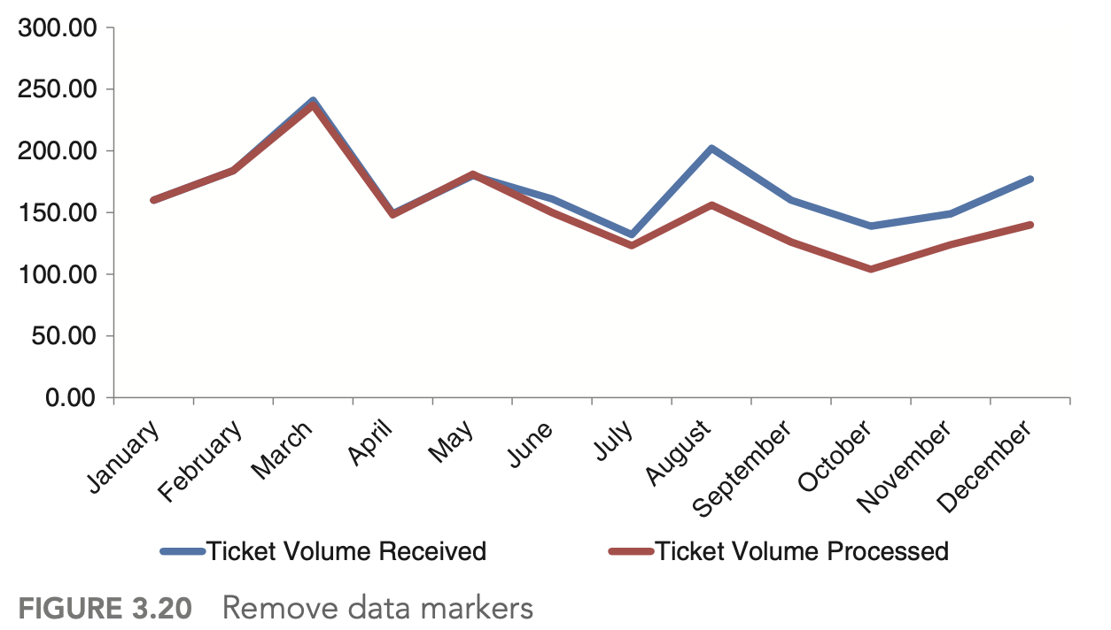
3. Decluttering
42

Slide 43
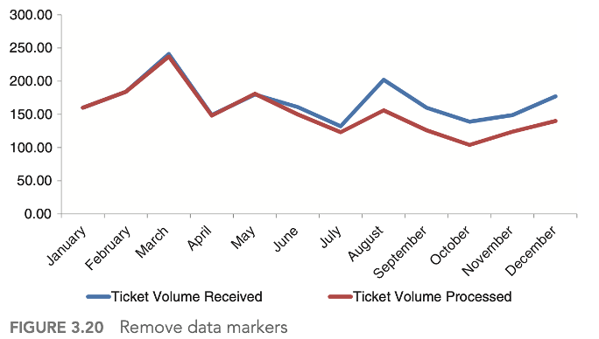
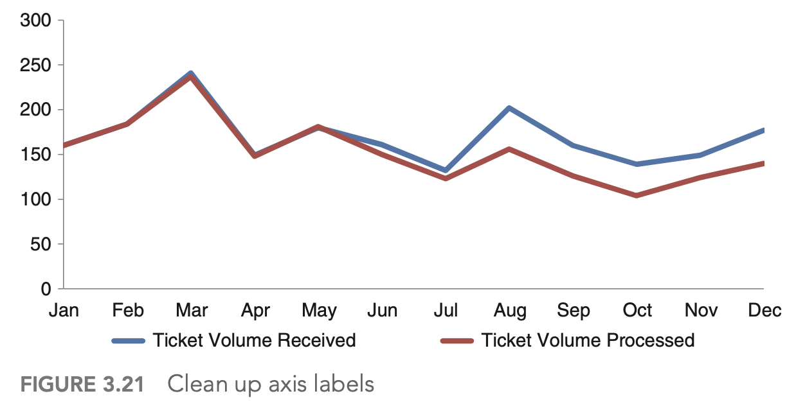
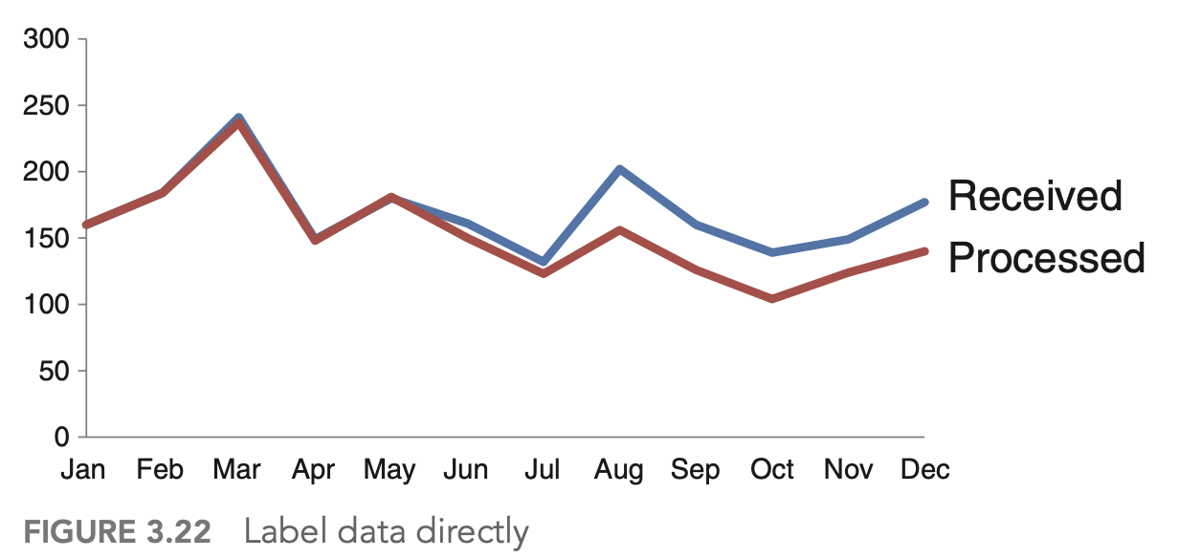
3. Decluttering
43

Slide 44
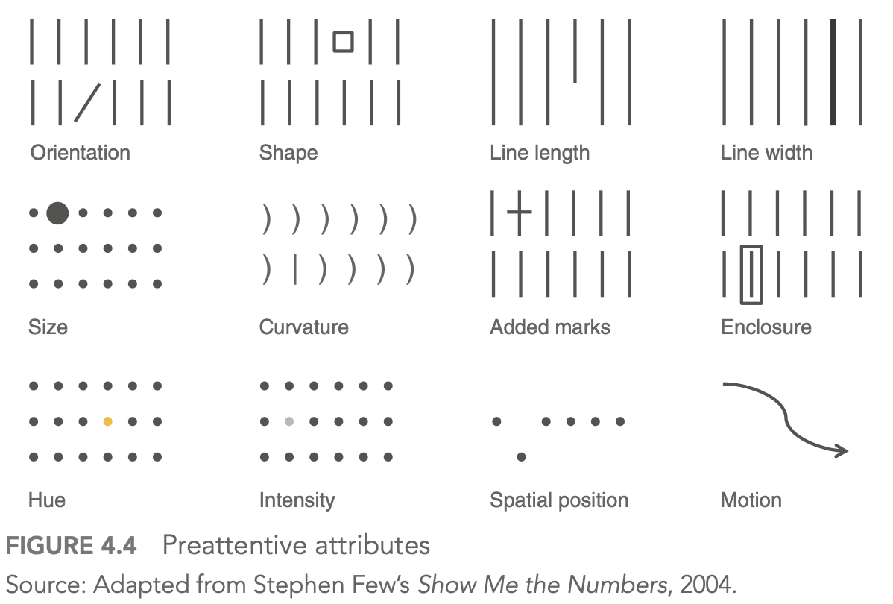
4. Focus attention where you want it
Preattentive attributes signal where to look:
44

Slide 45
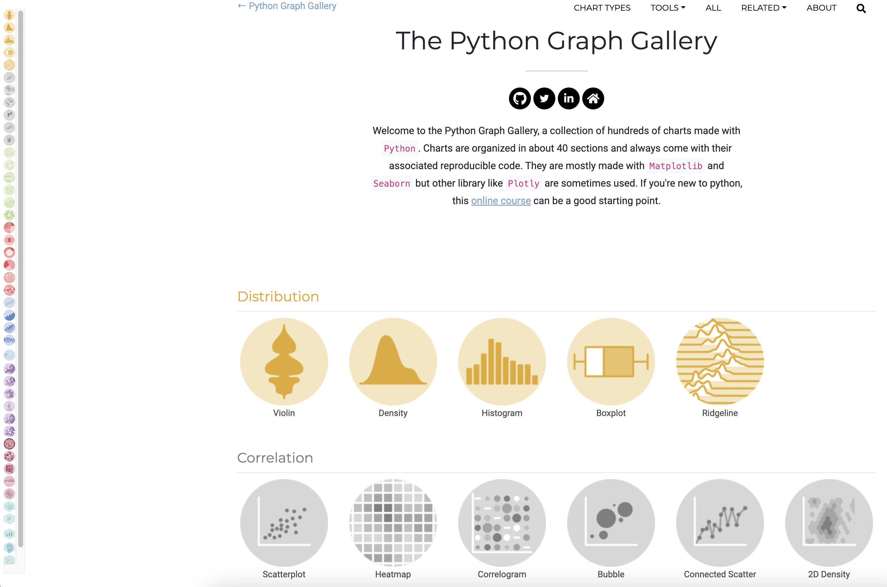
For Python users:
https://python-graph-gallery.com
45

Slide 46


THANKS
FOR YOUR
ATTENTION

Slide 47







Frankfurt School of Finance and Management gGmbH
Adickesallee 32-34 60322 Frankfurt am Main
Vorname Nachname
Position
Telefon: +49 69 154008-0
Fax: +49 69 154008-650
E-Mail: info@fs.de
www.frankfurt-school.de
@frankfurtschool
facebook.com/FrankfurtSchool
youtube.com/FrankfurtSchoolLive
linkedin.com/company/frankfurtschool
instagram.com/frankfurtschool

